Slide 1

Outsourcing

Slide 2
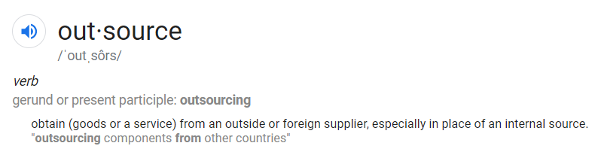
What is outsourcing?

Slide 3
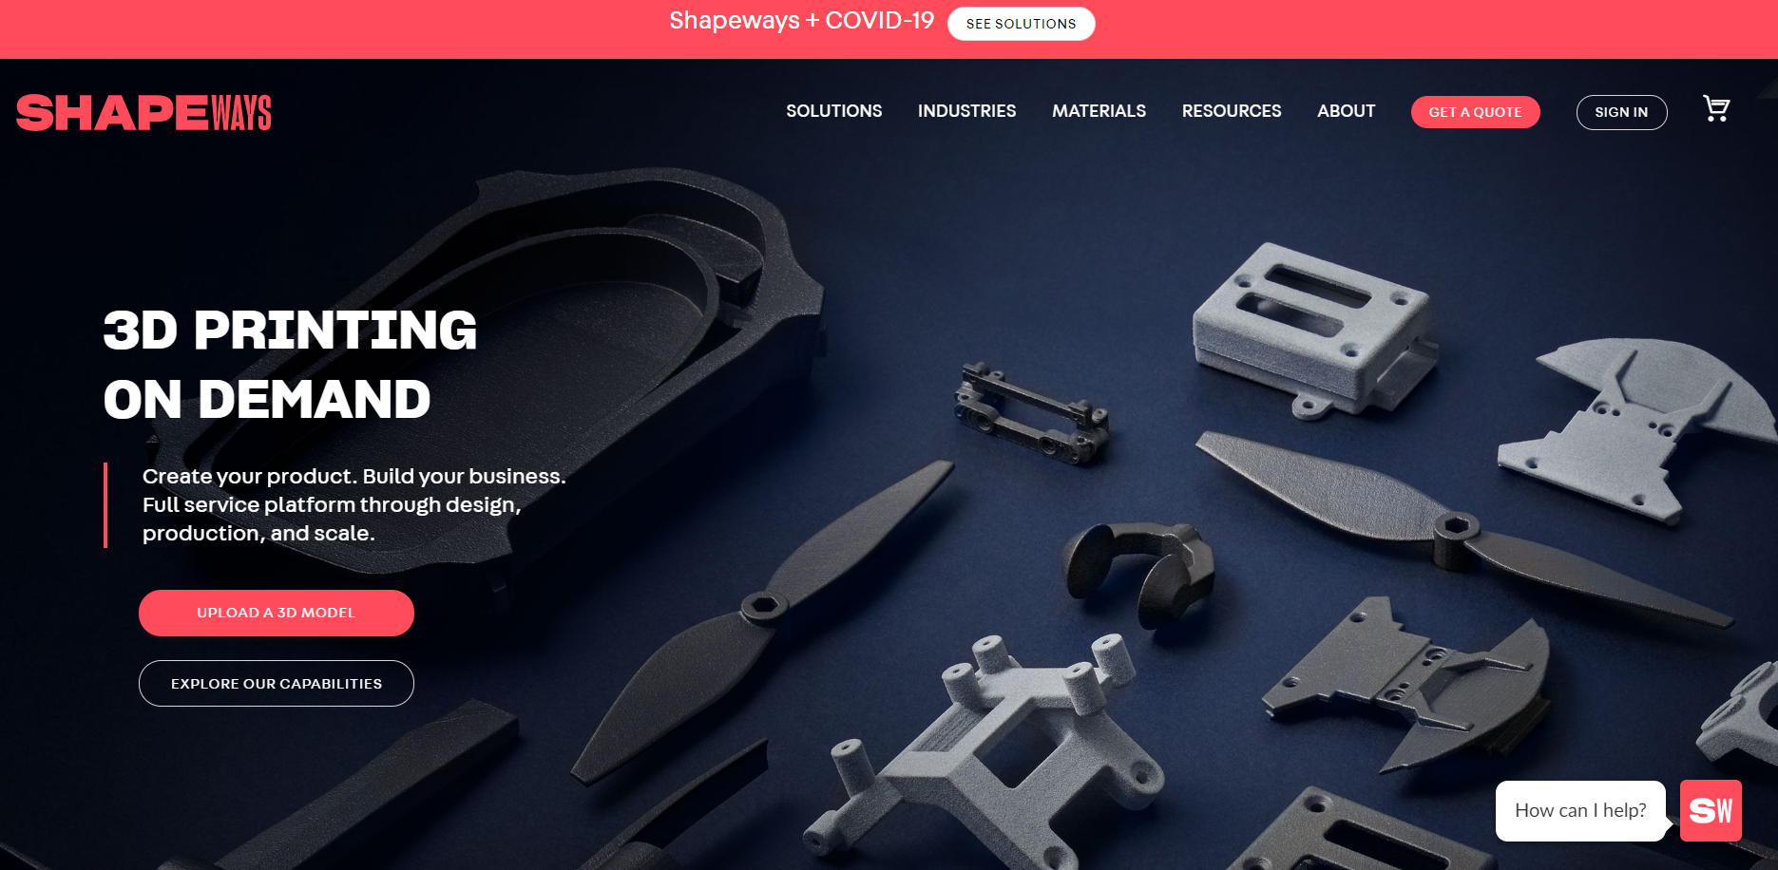
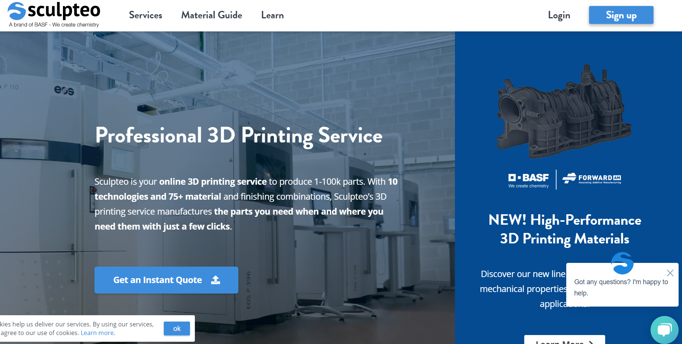
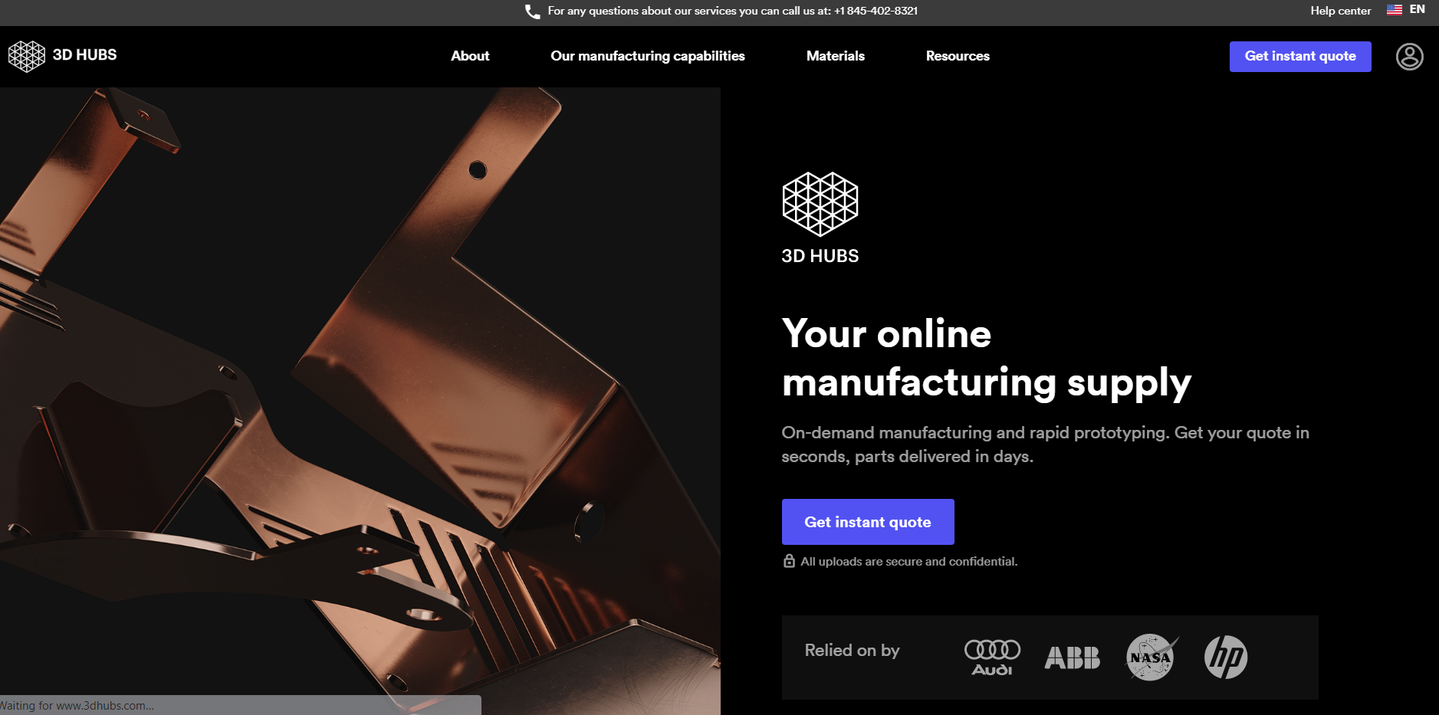
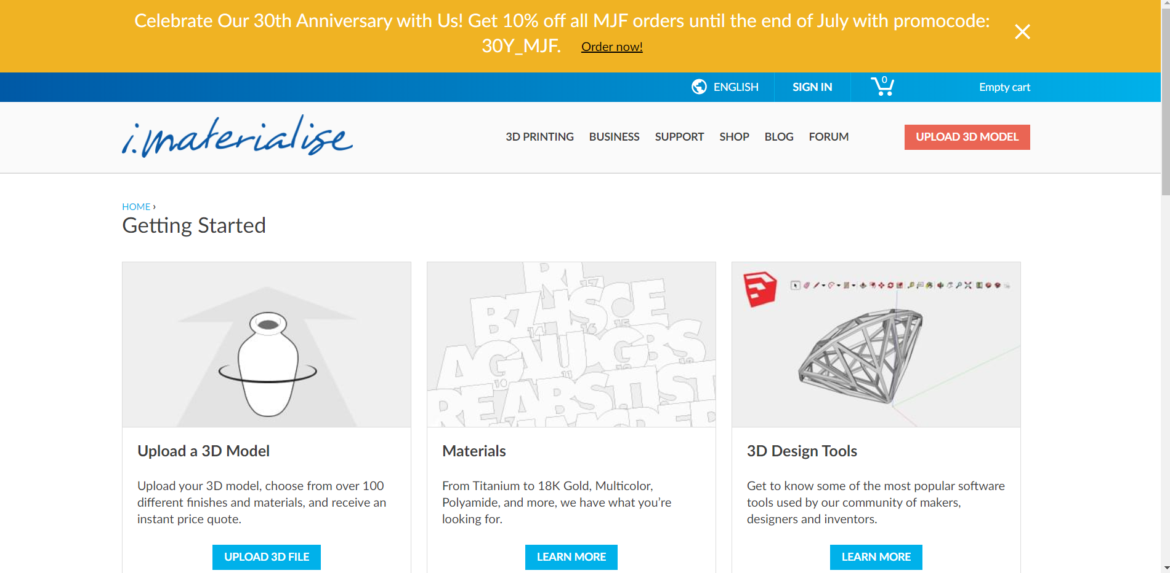
Popular Companies
Shapeways
Sculpteo
3D Hubs
i.Materialise

Slide 4
Things to Consider While Outsourcing
Material
Cost
Time
Shipping / Country of origin
Ethics

Slide 5
Material

Slide 6
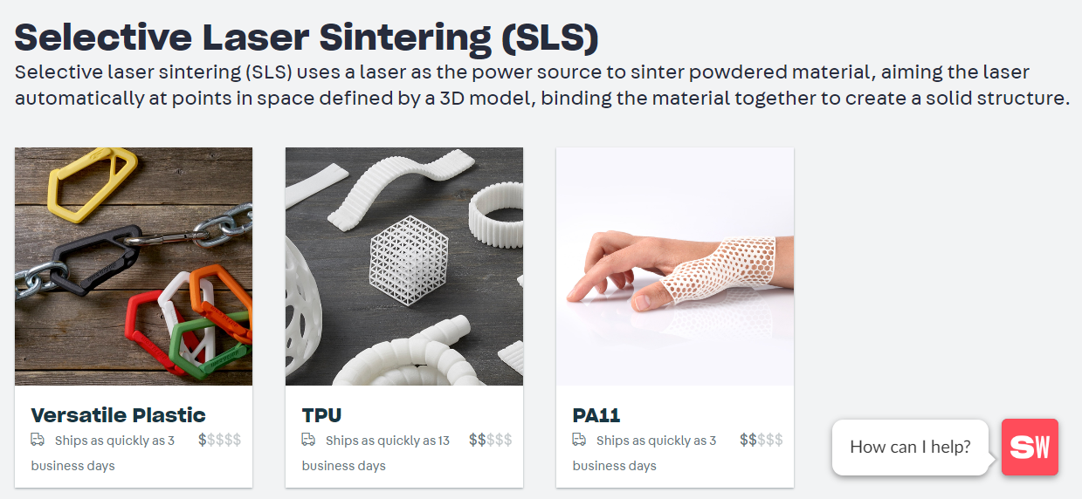
Plastics

Slide 7
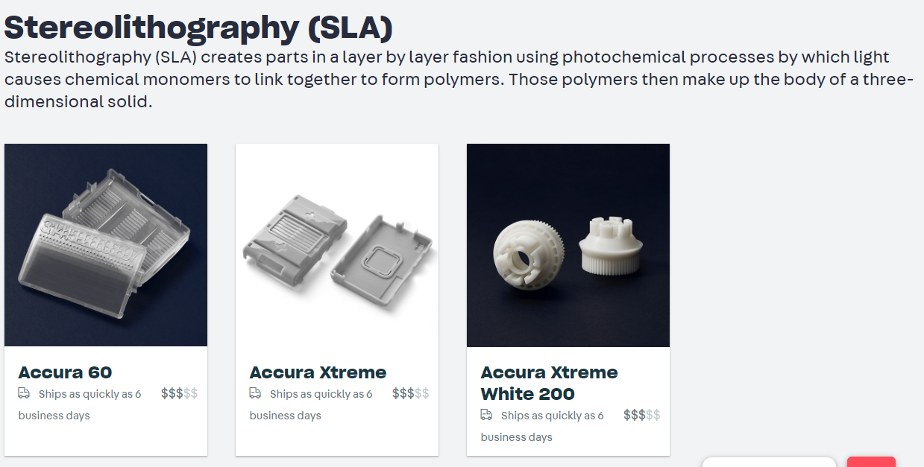
Resin

Slide 8
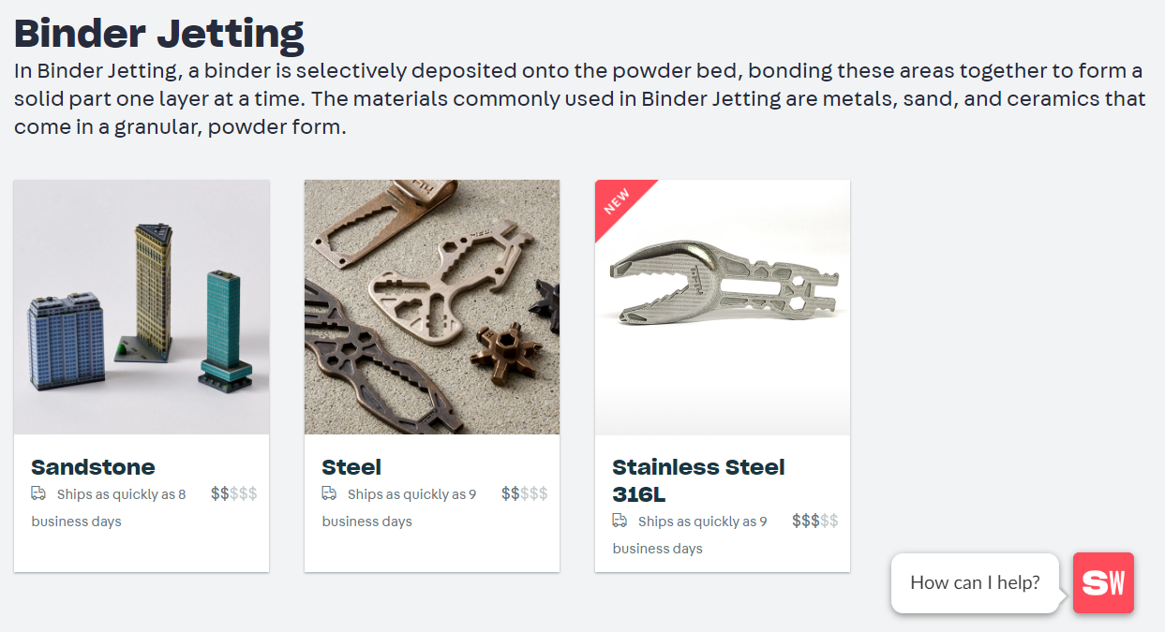
Sandstone/ Steel

Slide 9
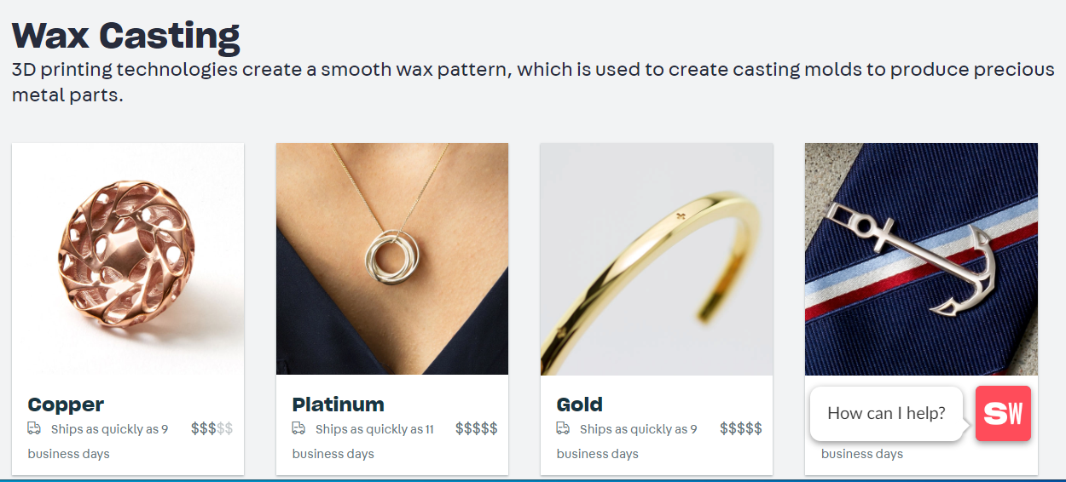
Precious Metals

Slide 10
Cost

Slide 11
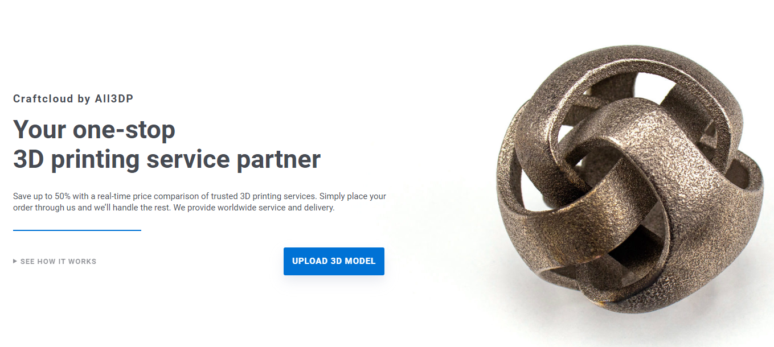
Craft Cloud from All 3DP
Upload File
Select Material
Compare Prices from Dozens of Companies
https://craftcloud3d.com/?utm_source=all3dp&utm_campaign=navbar

Slide 12
Time/ Shipping

Slide 13
Time Considerations
Do I need my object fabricated to meet a certain deadline?
You will usually need to give companies at least 3 weeks.
Do I need to make multiple prototypes? How can I check scale, or if parts fit together?
Check material properties lists from the company to see how much particular materials shrink.

Slide 14
Ethics

Slide 15
Labor/ Waste
Is the company green/ environmentally sustainable?
Can the material I use be recycled later on?
How are the employees treated? Have there been any reports about mistreatment?

Slide 16
Laser Cutting

Slide 17
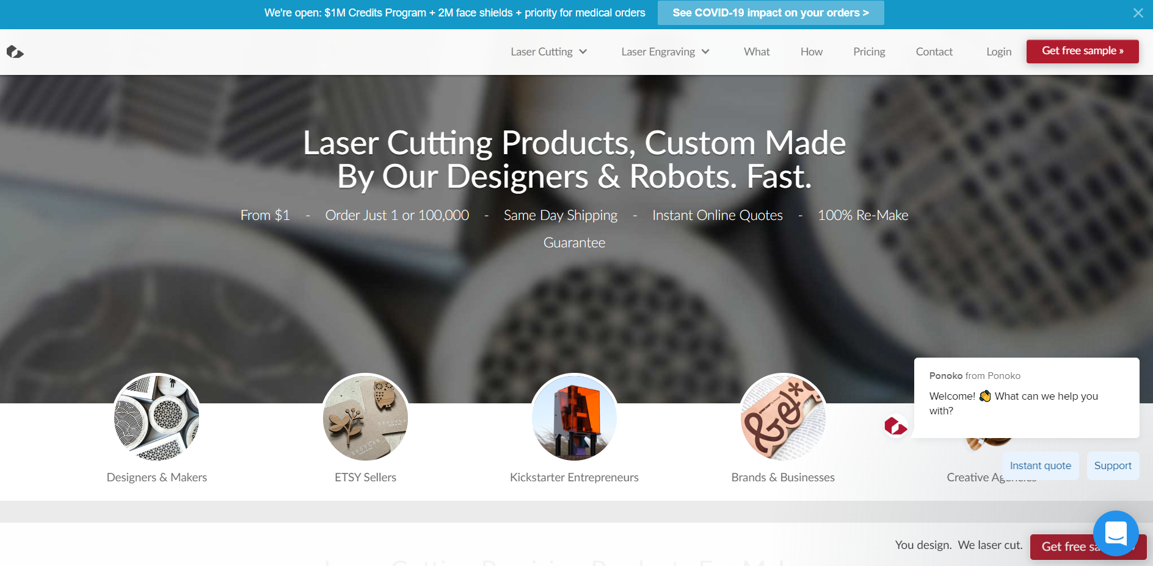
Ponoko (Also Xometry, Cotter, Sculpteo, Lasergist)

Slide 18
Materials
Aluminum (2024-T3 - 7075-T6)
Brass (C360, 260)
C932 M07 Bearing Bronze
Copper (101, C110)
ABS
Acetal [Delrin]
Acrylic
G-10 Garolite
Nylon 6/6
PEEK
Polycarbonate
PTFE [Teflon]
Polypropylene
Ultra-High Molecular Weight Polyethylene
Alloy Steel (4130, 4140)
Stainless Steel (15 - 420)
Steel (1018, A36)
Titanium (6Al-4V, Grade 2)
Zinc Sheet Alloy 500

Slide 19
Electronic Cutting

Slide 20
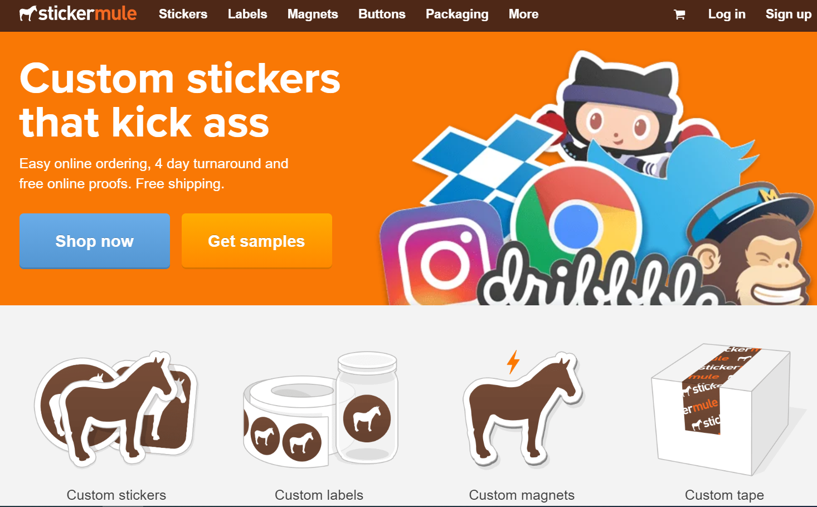
Sticker Mule (Sticker Giant, Stickeryou, )

Slide 21
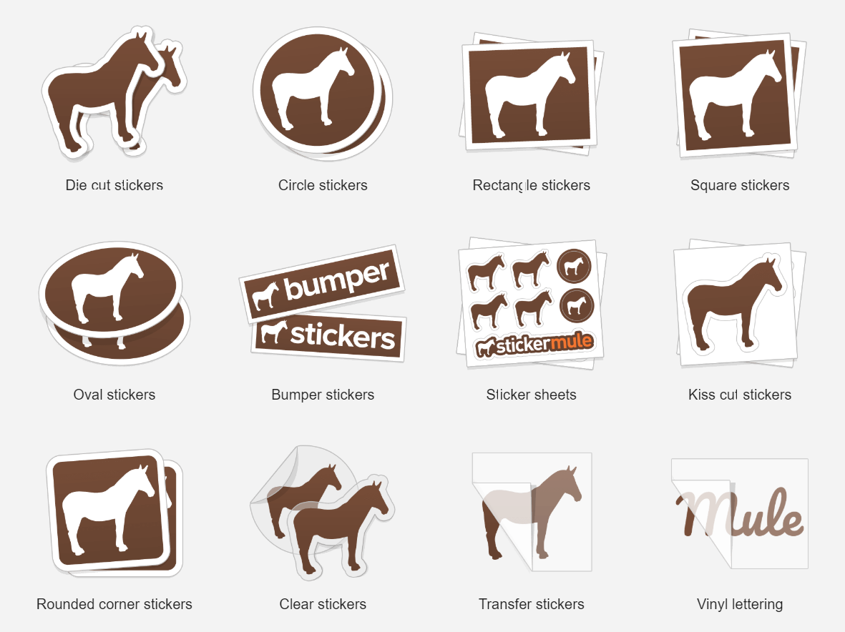
Sticker Mule

Slide 22
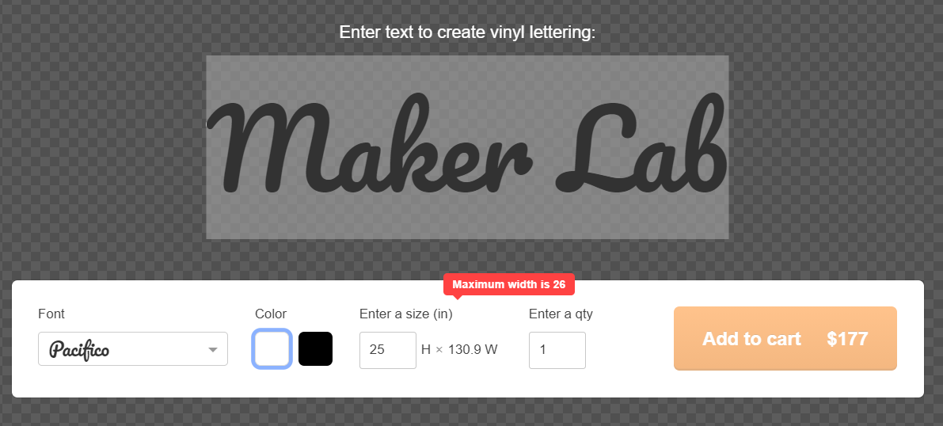
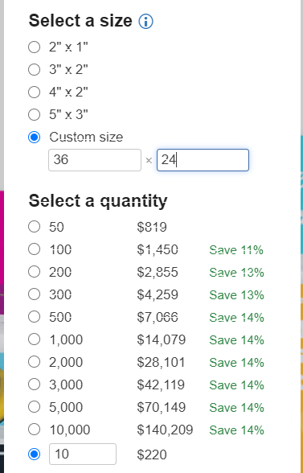
Sticker Mule

Slide 23
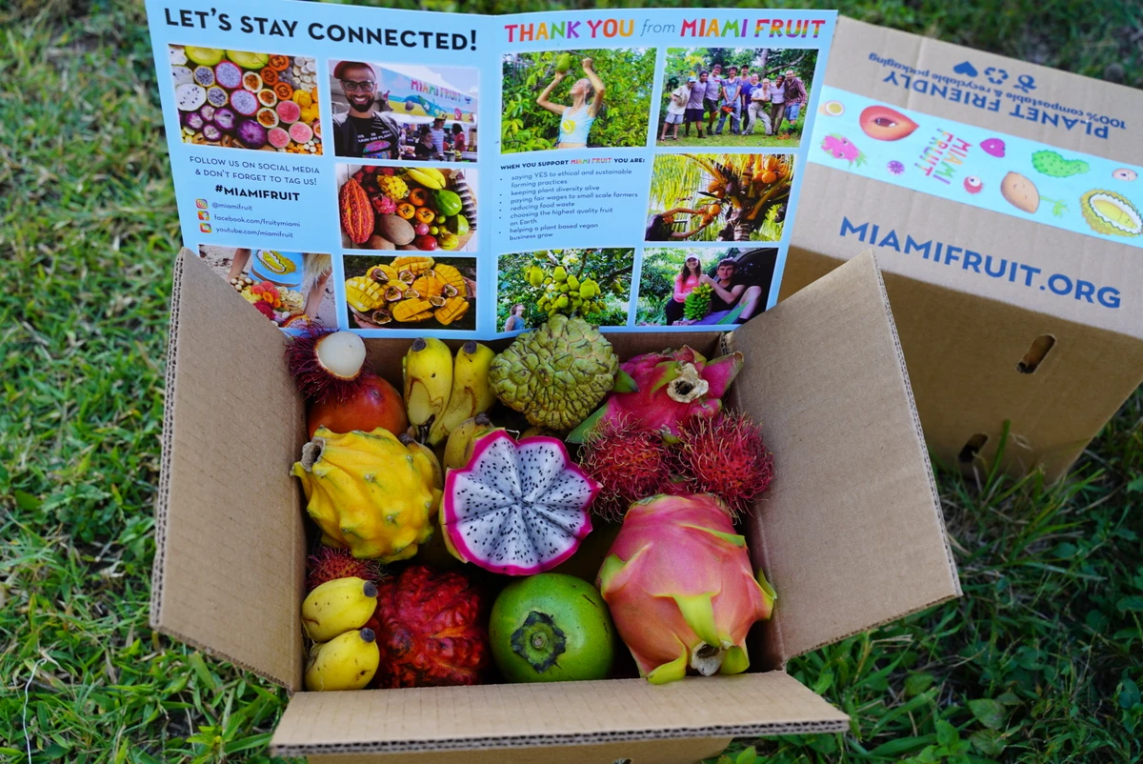

Miami Fruit

Slide 24
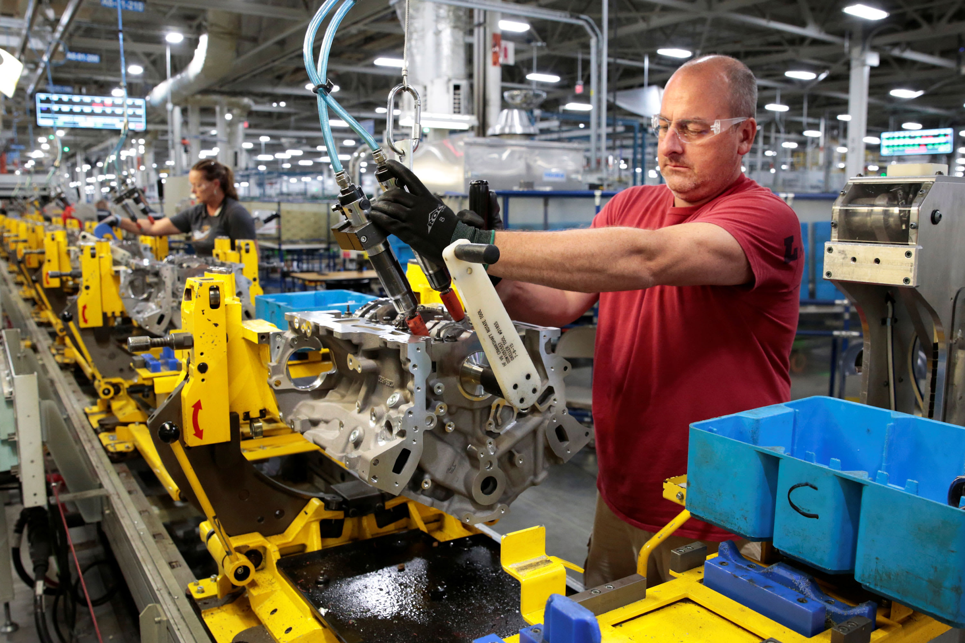

Manufacturing on a Large Scale
If you need to make 100+ of an item, you might want to contact a company to make your product.
Previously mentioned outsourcing companies can still be used for cheap prototypes, but you shouldn’t use them to make 100 of an item in most circumstances.
Craftcloud from All3DP lets you compare with quantity as a setting

Slide 25
Contact us with questions!
makerspace@chipublib.org

